Slide 1
Are Restaurant Reviews Trustworthy?
Vincent Ji
January 2020

Slide 2
Agenda
Online Review Background
Obao Midtown East Investigation
Takeaways

Slide 3
”94% of Diners Will Choose Your Restaurant Based on Online Reviews.”
– Michael Guta (Small Business Trends)
”For restaurants hoping to capture a slice of the $44 billion that tourists to NYC spend, TripAdvisor is one of the most effective ways to do it.”
– Diana Hubell (NY Eater)

Slide 4
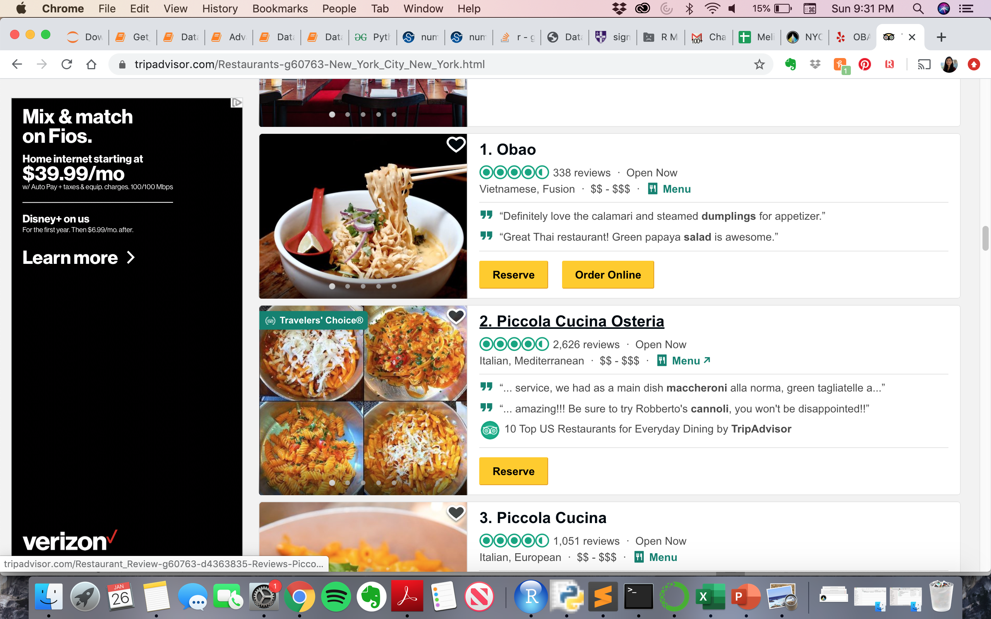
Obao ranks #1 on TripAdvisor but only has 3.5 stars on Yelp. Unusually high percentage of visitors gave the restaurant a five-star rating on TripAdvisor
Over 60% of the Tripadvisor reviewers gave five-stars

Slide 5

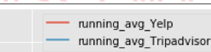
Obao’s rating on Tripadvisor spiked after November 2019 which coincided with a sudden increase in number of reviews in December 2019 and January 2020.
Surge in rating
Tripadvisor

Slide 6
More than half of the reviews in Dec’19 and Jan’20 were from first time reviewers. In addition, average rating for the period is an eye-popping 4.99. This doesn’t make sense…
 | Before or in Nov’19 | After Nov’19
Total # Reviews | 206 | 131
# Reviews From First Time Contributors | 2 | 79
Avg. Rating | 3.50 | 4.99
What caused such drastic change?

Slide 7
More than half of the reviews in Dec’19 and Jan’20 were from first time reviewers. In addition, average rating for the period is an eye-popping 4.99. This doesn’t make sense…
 | Before or in Nov’19 | After Nov’19
Total # Reviews | 206 | 131
# Reviews From First Time Contributors | 2 | 79
Avg. Rating | 3.50 | 4.99
After reaching out to one of the reviewers (my former colleague), I found out that the restaurant offered a free drink for each customer who wrote a review on Tripadvisor while dining.

Slide 8
More than half of the reviews in Dec’19 and Jan’20 were from first time reviewers. In addition, average rating for the period is an eye-popping 4.99. This doesn’t make sense…
“Tripadvisor encourages businesses to ask all customers to write reviews and share their feedback. However, we do not allow offering any kind of incentive for a review because this can impact the impartiality of that review. Under our incentives policy, we penalize any businesses that are found to be offering incentives to customers.”
- Tripadvisor policy
 | Before or in Nov’19 | After Nov’19
Total # Reviews | 206 | 131
# Reviews From First Time Contributors | 2 | 79
Avg. Rating | 3.5 | 4.99
After reaching out to one of the reviewers (my former colleague), I found out that the restaurant offered a free drink for each customer who wrote a review on Tripadvisor while dining.

Slide 9
Takeaways and Future Works
Customers need to look beyond aggregate ratings and ranking to find the right product for them.
Review websites such as TripAdvisor are built on credibility and user trust. They need to evolve their review platforms to prevent businesses from gaming the system.
Recommendation: adding a question before the review section asking review writers if they were asked by the business to write a review
Scale this analysis to more reviews on Tripadvisor or other review sites and create monitoring tools to detect biased review behaviors.

